Slide 1
Weekly meeting 6
Shengya Guo, CR/AVS3, 31.07.2024

Slide 2

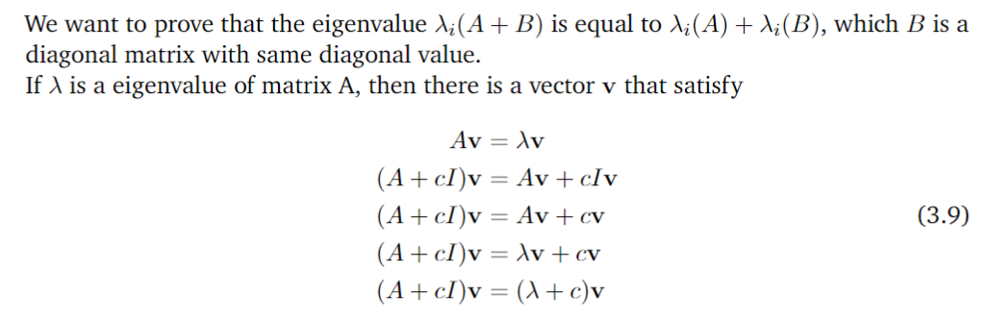
Courant-Fircher theorem

Slide 3
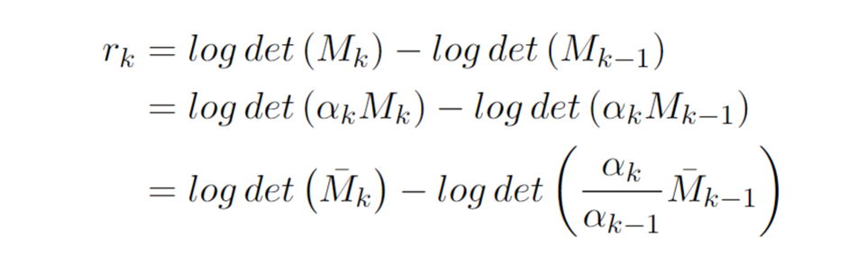
Rescale FI matrix

Slide 4
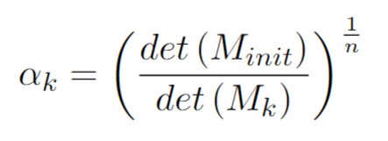
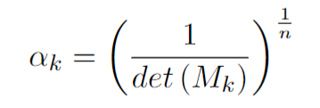
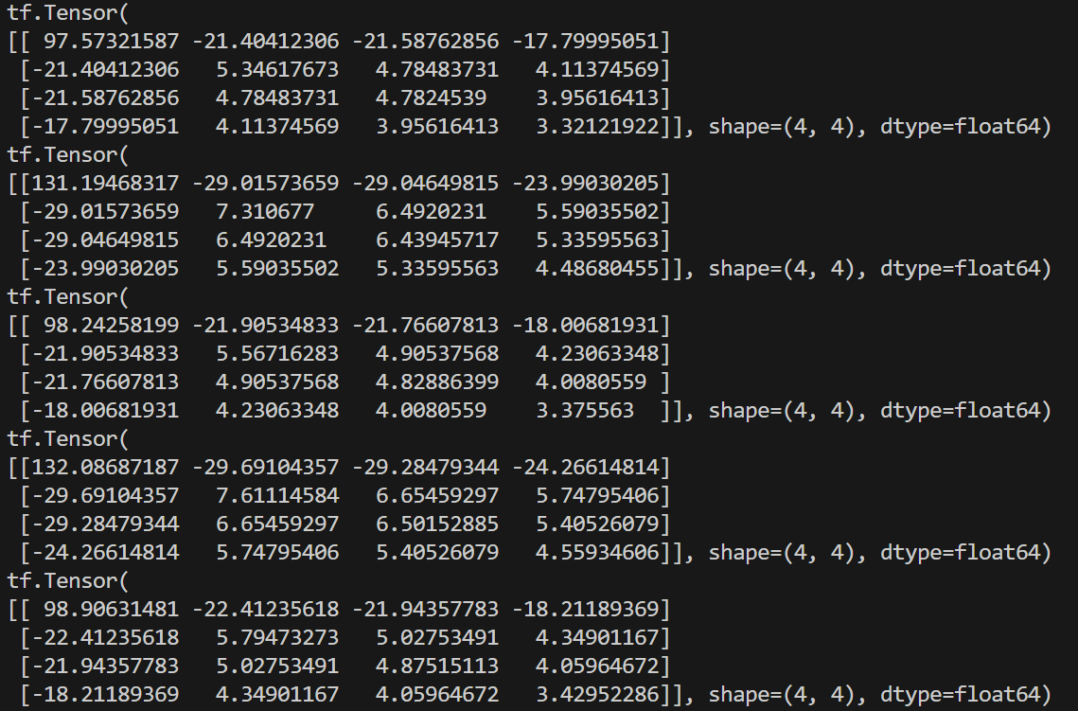
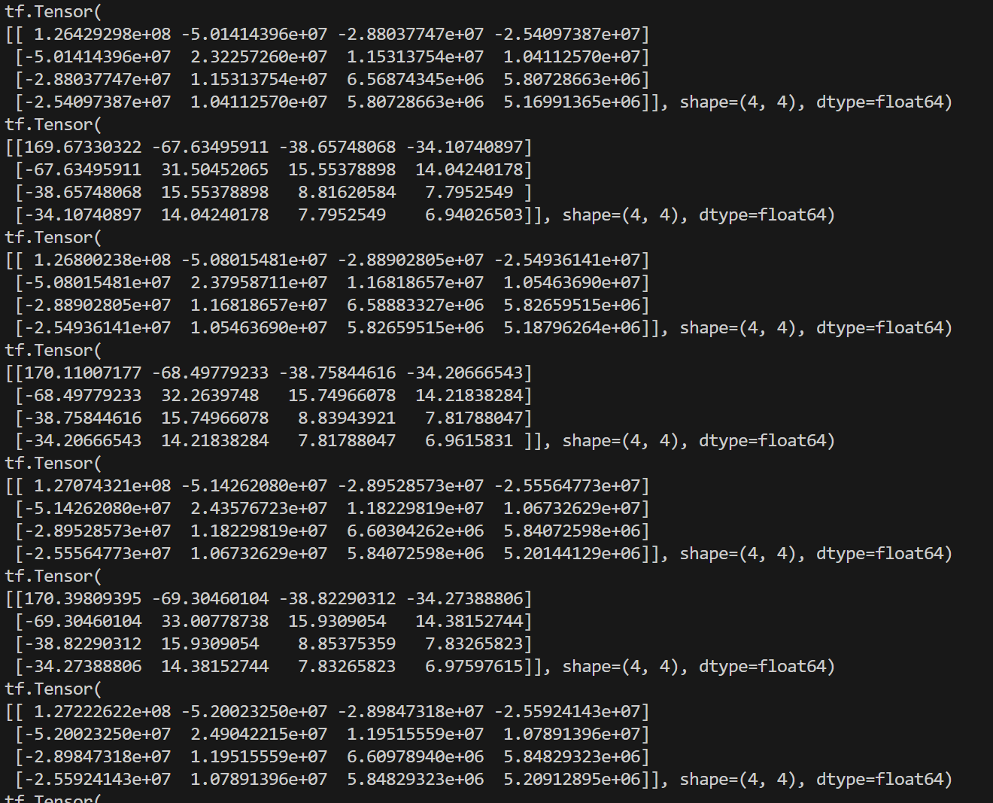
Rescale FI matrix

Slide 5
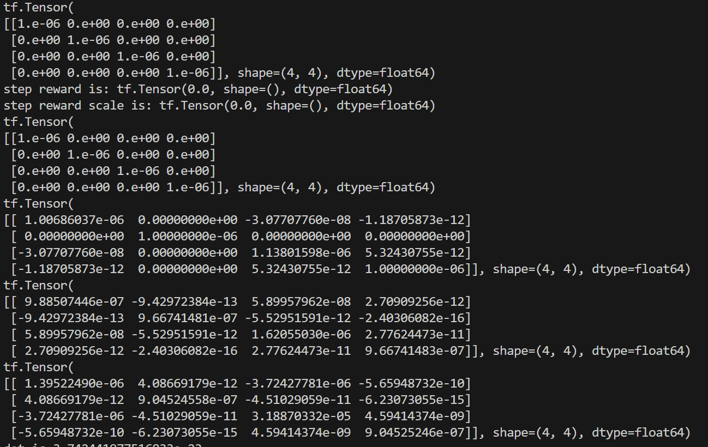
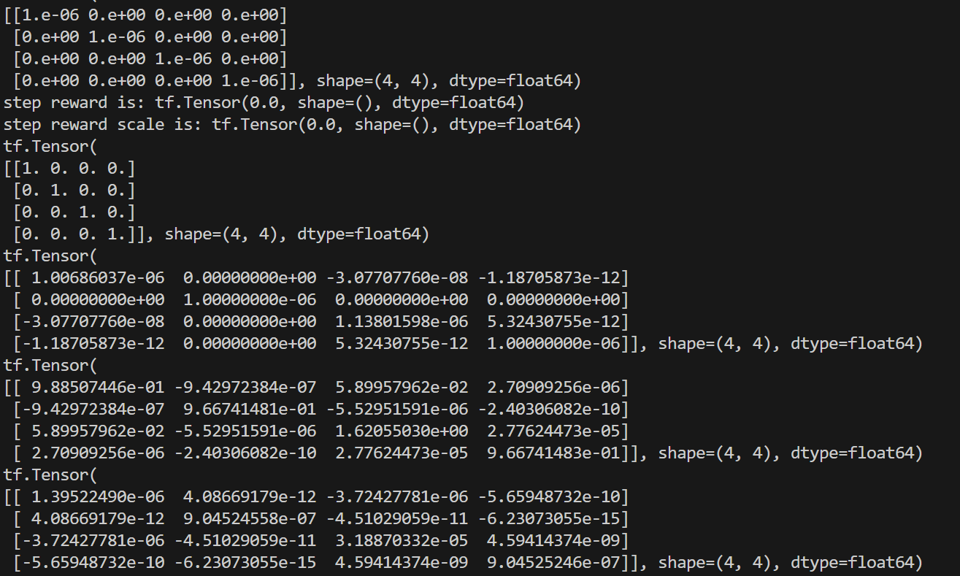
Courant-Fircher theorem

Slide 6
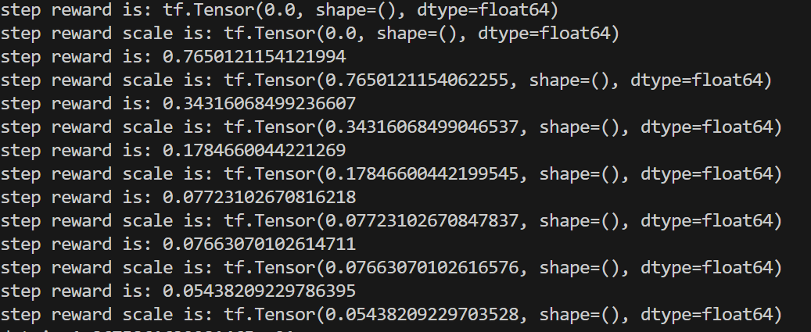
Result with rescale FI matrix
Record the setp reward each 50 time step

Slide 7
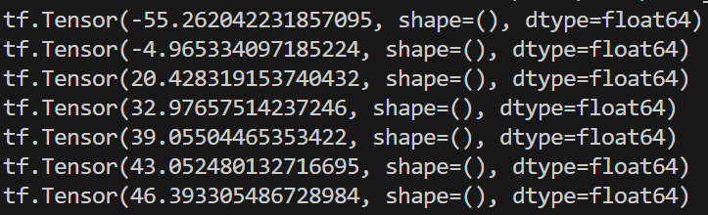
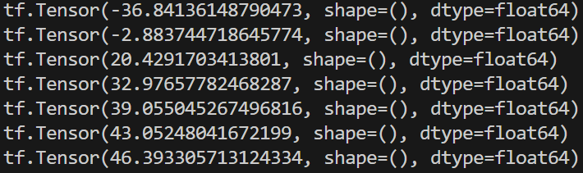
Result with different initial FI matrix
Record the total reward each 50 time step
M_init | np.eye(4) * 1e-6 | np.eye(4) * 1e-4
log det(M_init) | -55.26 | -36.84

Slide 8
Next
Approaches used in RL with partial observation my be helpful
Start with the agent I,a in the paper
Consider use MPC as benchmark
Use RNN for history dependent policy, RNN generate the input of Agent
Asymmetric AC, the value network det full info but actor learns the partial observability
POMDP

